Slide 1

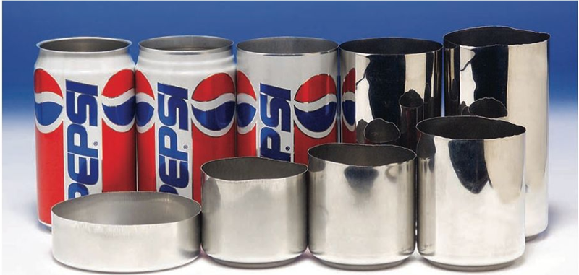

Slide 2

Engineering in Al Can
https://youtu.be/hUhisi2FBuw
11 min
Notes:
Too long for class but very interesting. Include so students have link.

Slide 3
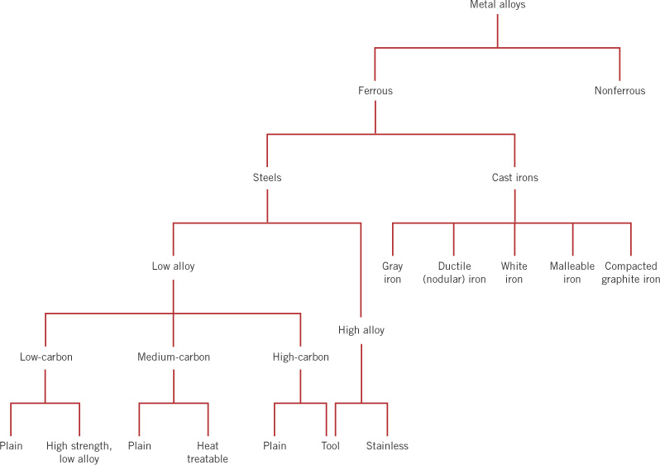
c13f01
Classification
of metal alloys
Fe
Al, Cu, Mg, Ti,
Co, Ni, etc.
0.008 - 2.1% C
most < 1% C
3 - 4.5% C
1 - 3% Si
< 5% alloys
most
> 10%
alloys
< 0.25% C
0.25 - 0.6% C
> 0.6% C
HSLA
> 11% Cr
Notes:
Note from phase diagram cast irons melt at lower temperatures than steels and are generally cast.

Slide 4

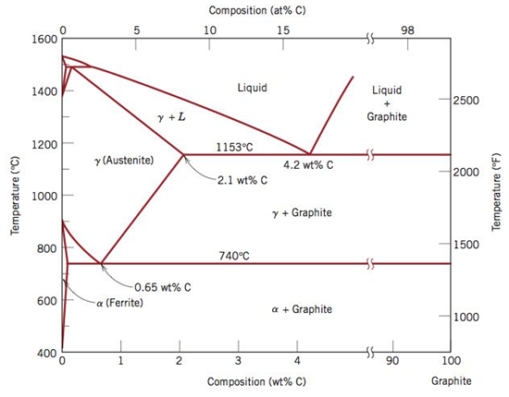
Cast Iron (> 2.14 wt%)
Typically between 3 and 4.5 wt%
Notes:
True equilibrium phase diagram. Cementite is actually metastable and decomposes to alpha-iron and graphite. Slower cooling rates and presence of Silicon (>1 wt%) promotes graphite formation. Cast irons typically have graphite not cementite.

Slide 5
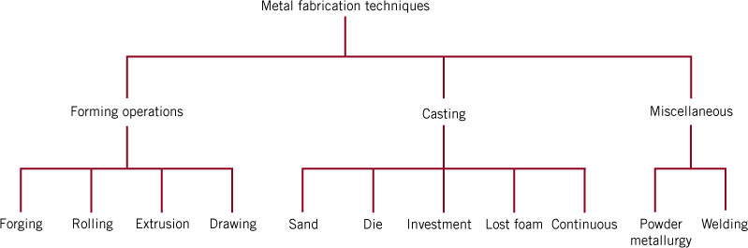
c14f01
Chapter 11: Processing of Metals
wrought metals
Machining

Slide 6
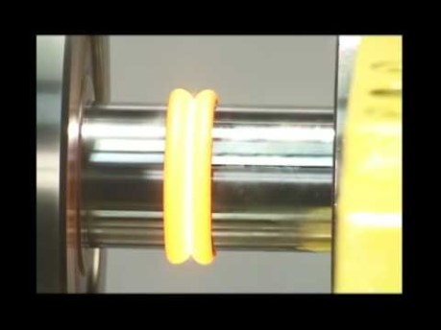
Processing Movies:
Forging
10 min
Friction Welding
1 min
How It's Made - Pliers
5 min
Making of Al Foil
5 min
Powder Metallurgy
2 min
Investment Casting
2 min

Slide 7
c13f01
Recall: Classification
of metal alloys
Fe
Al, Cu, Mg, Ti,
Co, Ni, etc.
0.008 - 2.1% C
most < 1% C
3 - 4.5% C
1 - 3% Si
Let’s look at:
How to measure the affect of processing on mechanical behavior of steel
Precipitation hardening e.g. Al-Cu and Cu-Be
< 5% alloys
most
> 10%
alloys
< 0.25% C
0.25 - 0.6% C
> 0.6% C
HSLA
> 11% Cr

Slide 8
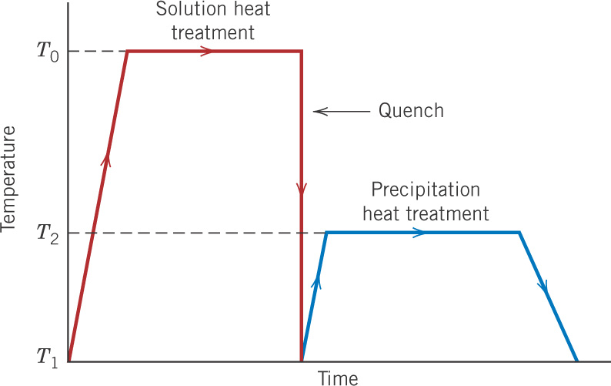
c11f41
Recall: Quenching and
tempering of steels
Austenitize
γ (FCC) structure
Temper to form
α (BCC) + Fe₃C
(one to a few hours)
Martensite, BCT
very hard, brittle
(From Ch. 11)

Slide 9
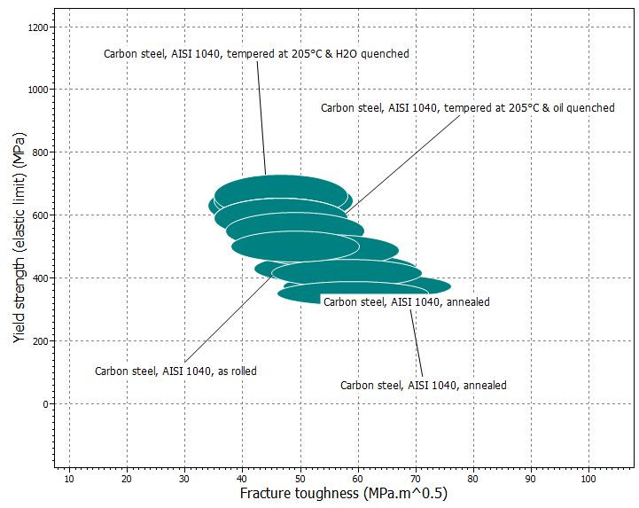

Slide 10
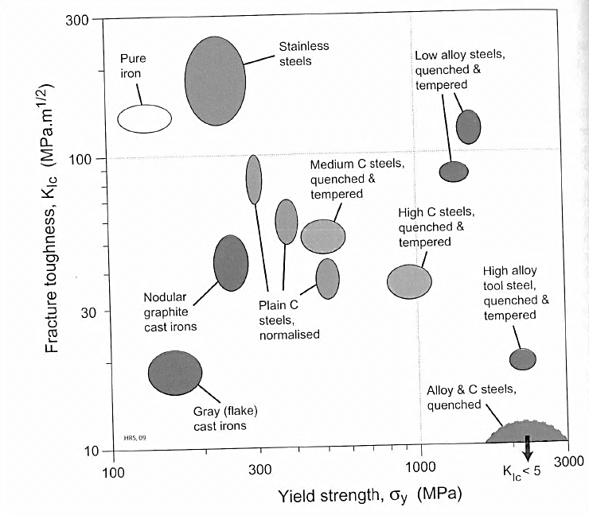

Slide 11
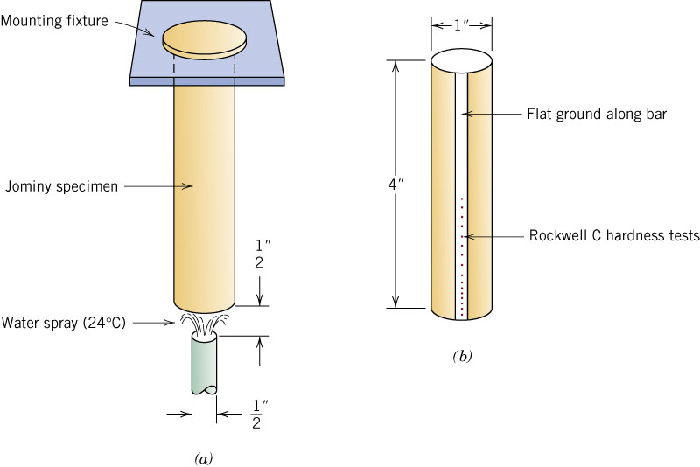
c14f05
Jominy end-quench bar

Slide 12
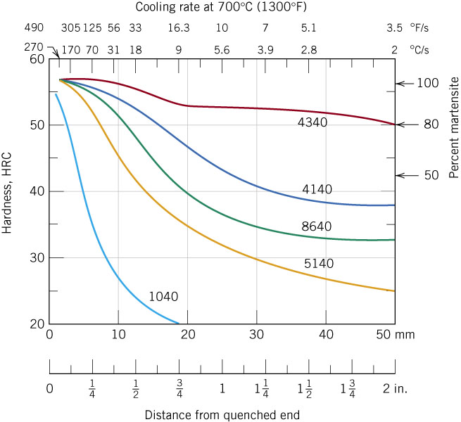
c14f08
Hardness versus Jominy bar position for several steels
These are called
hardenability curves.

Slide 13
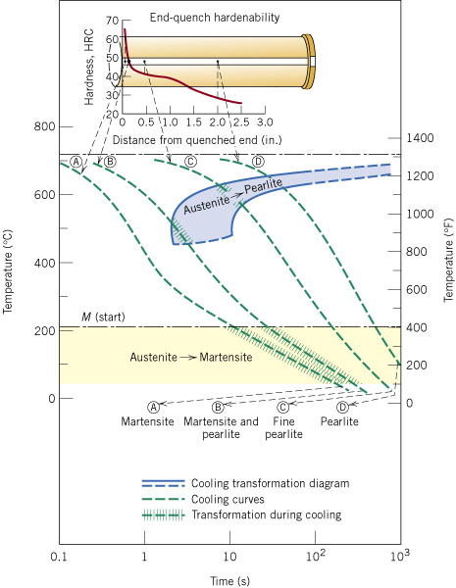
c14f07
Cooling curves for
eutectoid steel
(AISI 1076)

Slide 14
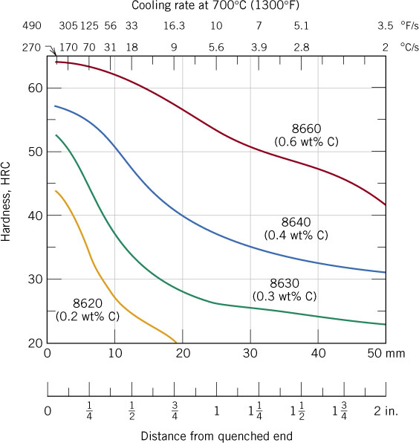
c14f09
Hardenability curves for AISI 86XX steels
Effect of carbon content

Slide 15
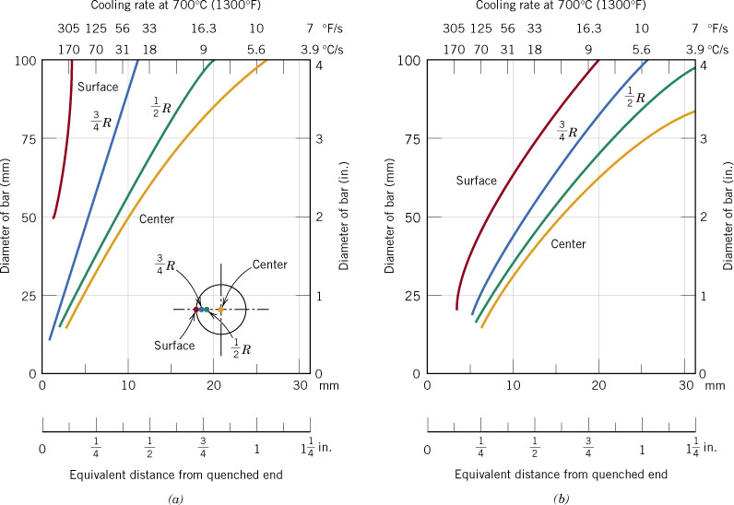
c14f11
Equivalent Jominy bar distances
- for various locations in bars of different diameters
Water quench
Oil quench

Slide 16
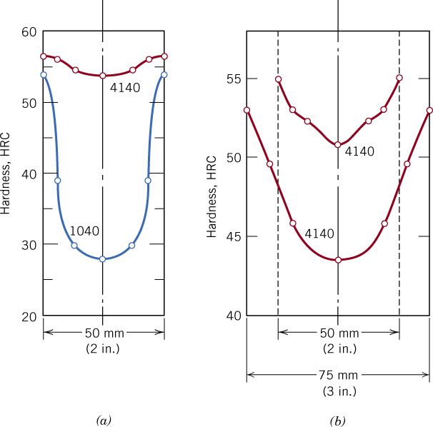
c14f12
Examples of hardness profiles after quenching
Water quench
Oil quench

Slide 17
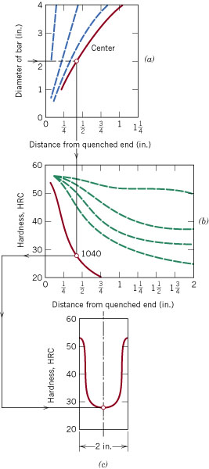
c14f13
Example - Procedure for
estimating hardness profiles
Equivalent distance curves
Hardenability curve
Hardness profile

Slide 18
This process is used for Al alloys, Ti alloys, Be-Cu alloys, and certain specialty steels.

Slide 19
c11f41
Precipitation hardening procedure
There is no phase
transformation
in the major alloy.
Single phase
solid solution
“Aging” to form
precipitates
Supersaturated
solution - soft

Slide 20
c11f41
Precipitation hardening procedure
There is no phase
transformation
in the major alloy.
Single phase
solid solution
Note that although this looks similar to the heat treatment procedure for tempered martensite the mechanism is completely different.
Let’s look at the phase diagram for a precipitation hardening alloy to see what is happening.
“Aging” to form
precipitates
Supersaturated
solution - soft
Notes:
Print the hidden slide for student handout.

Slide 21
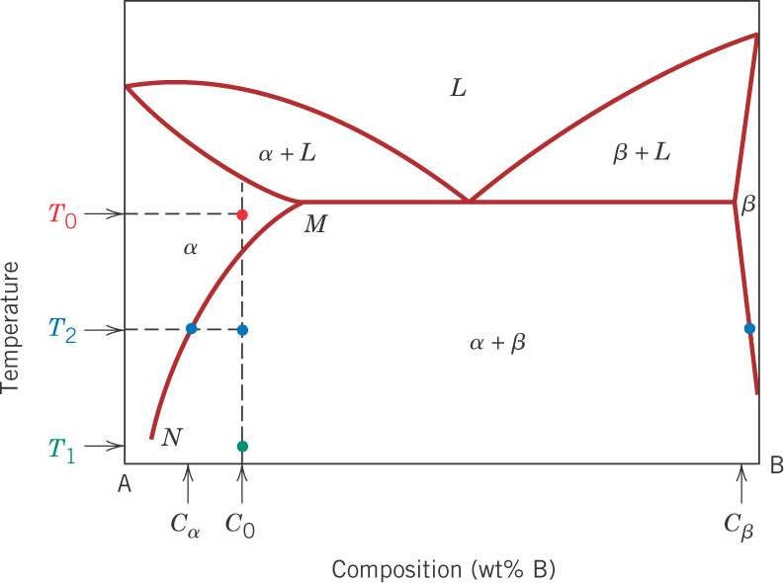
c11f40
Schematic phase diagram for precipitation hardening
A-B alloy (C₀ wt%) forms a solid solution at T₀. Quench to T₁, then
heat to T₂, where precipitate particles form, and finally cool slowly.
Notes:
T0 – Solution heat treatment; T1 – supersaturated alpha phase; T2 – precipitation heat treatment (“aging”)

Slide 22
c11f40
Schematic phase diagram for precipitation hardening
A-B alloy (C₀ wt%) forms a solid solution at T₀. Quench to T₁, then
heat to T₂, where precipitate particles form, and finally cool slowly.
What do you think happens to mechanical properties at T2?
How about as we continue holding at T2?
Notes:
T0 – Solution heat treatment; T1 – supersaturated alpha phase; T2 – precipitation heat treatment (“aging”)

Slide 23
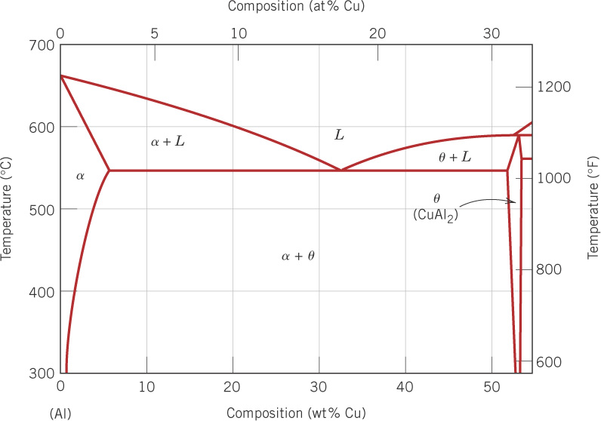
c11f43
Let’s consider a high strength Al alloy: Al-Cu
e.g. AA2024: 4.4% Cu, 1.5% Mg, 0.6% Mn and 93.5% Al

Slide 24
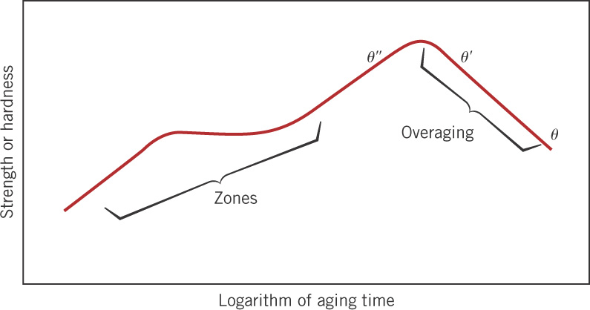
c11f42
Effect of aging time
Zones = very thin, small disks – 1 to 2 atoms thick, ~ 25 atoms in diam. – not distinct precipitate particles

Slide 25
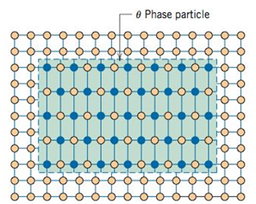
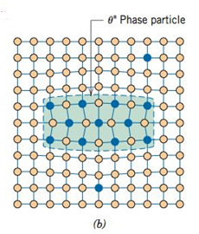
c11f42
Effect of aging time
Zones = very thin, small disks – 1 to 2 atoms thick, ~ 25 atoms in diam. – not distinct precipitate particles
Notes:
Theta double prime – coherent; theta prime – semicoherent; theta - incoherent

Slide 26
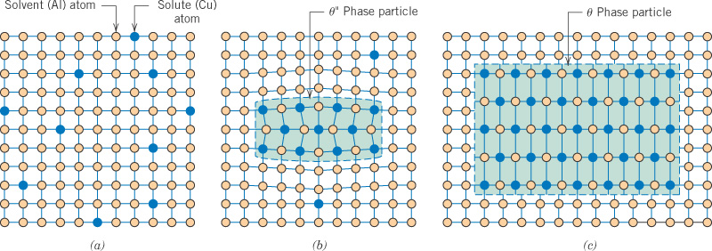
c11f44
Precipitate particles (schematic)
Very small, evenly dispersed, coherent precipitate particles
have the most benefit.
Supersaturated
solid solution
Coherent particle
Incoherent particle
(overaged)

Slide 27
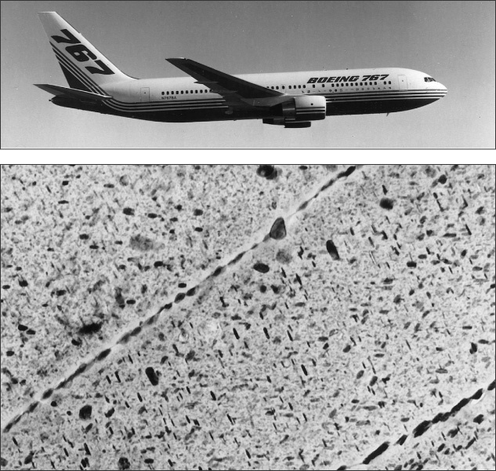
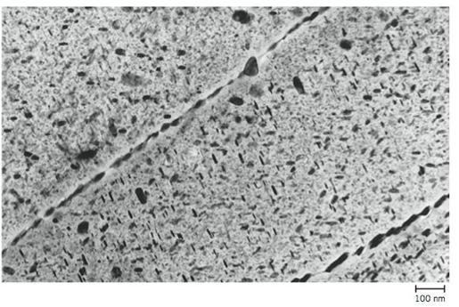
c11cof01
Precipitate
particles
Upper wing skin
7150-T651 Al
Al plus wt%
6.2Zn, 2.3Cu,
2.3Mg, 0.12Zr
80,500X TEM
Notes:
Note scale here. 100 nm bar!

Slide 28
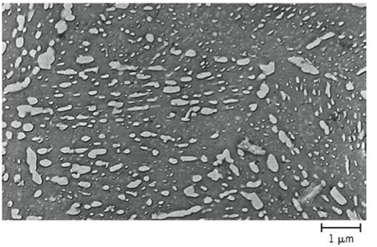
c11cof01
Precipitate
particles
Upper wing skin
7150-T651 Al
Al plus wt%
6.2Zn, 2.3Cu,
2.3Mg, 0.12Zr
80,500X TEM
Notes:
Note scale here. 100 nm bar!

Slide 29
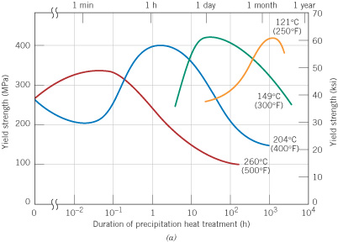
c11f45
2014-T6 Al 4.4Cu, 0.9Si, 0.8Mn, 0.5Mg
Effect of aging time
and temperature
σ_{yield}, MPa
time, h

Slide 30
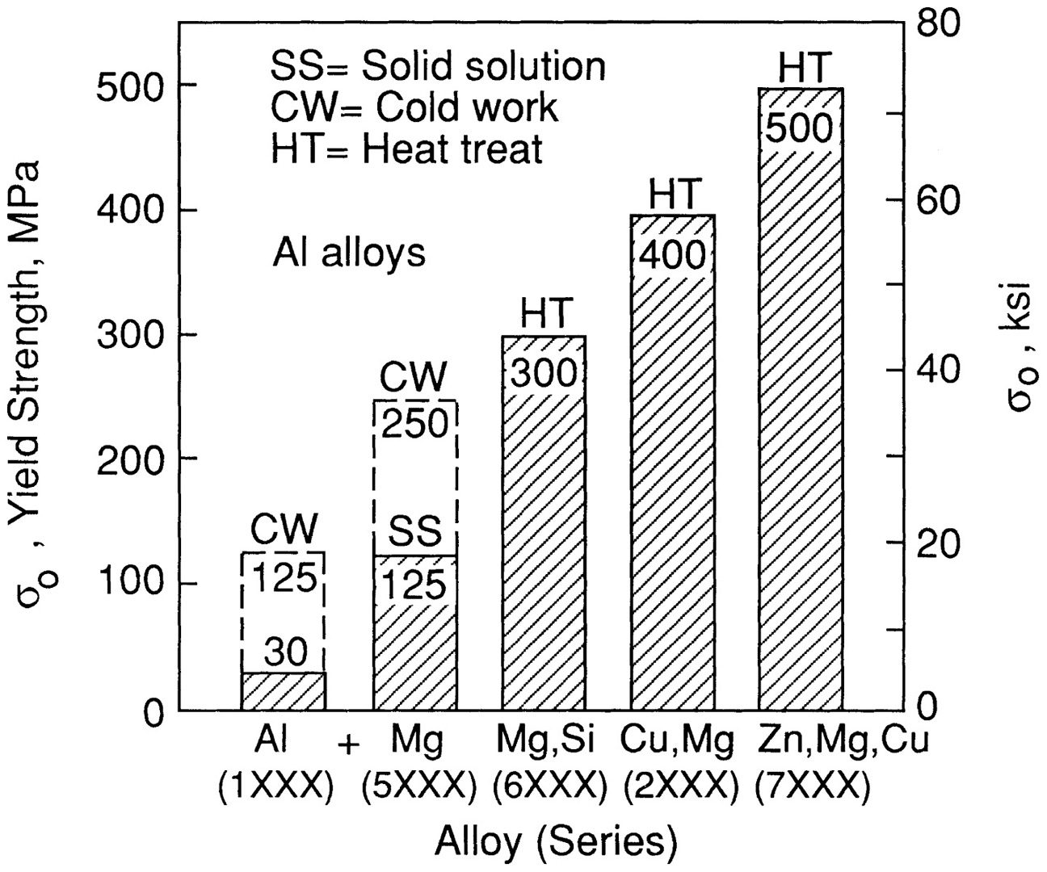
Aluminum Strengthening
Illustration by R. W. Landgraf

Slide 31
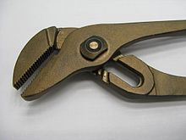
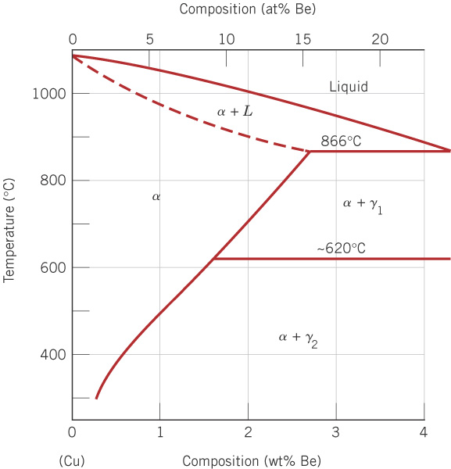
c11f51
Cu-Be phase diagram to 4% Be
Non-sparking tools, musical instruments, precision measurement devices, non-magnetic, low temperature applications.
Highest strength of the copper alloys.

Slide 32
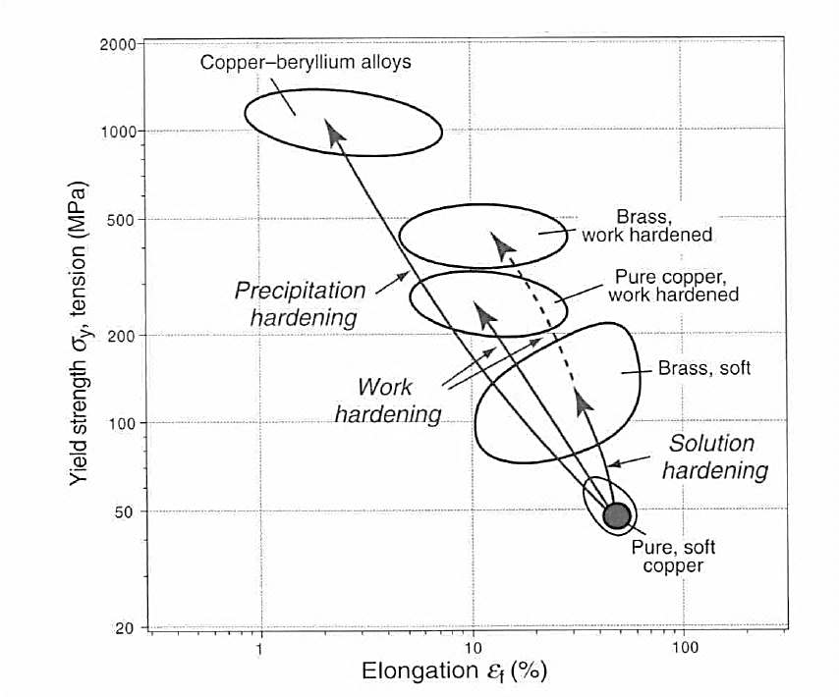
Strengthening of Copper

Slide 33
Summary: Thermal processing (heat treating) of metals
Annealing - heating, holding at temperature, and then slowly cooling, often to soften the metal.
Process anneal - done to remove the effects of cold work and achieve a fine grain structure.
Stress relief - removal of internal (residual) stresses using a relatively low temperature anneal.
Special annealing processes for steels - normalizing, full annealing, and spheroidizing.
Quenching and tempering - to harden and tailor the properties of steels (Ch. 11).
Precipitation hardening - to harden and tailor the properties of aluminum alloys and other metals (Ch. 11).
Notes:
Normalizing – refine grains – austenitize then cool according to CCT
Full Anneal – soften for further processing – austenitize then cool slowly in furnace

